Slide 1
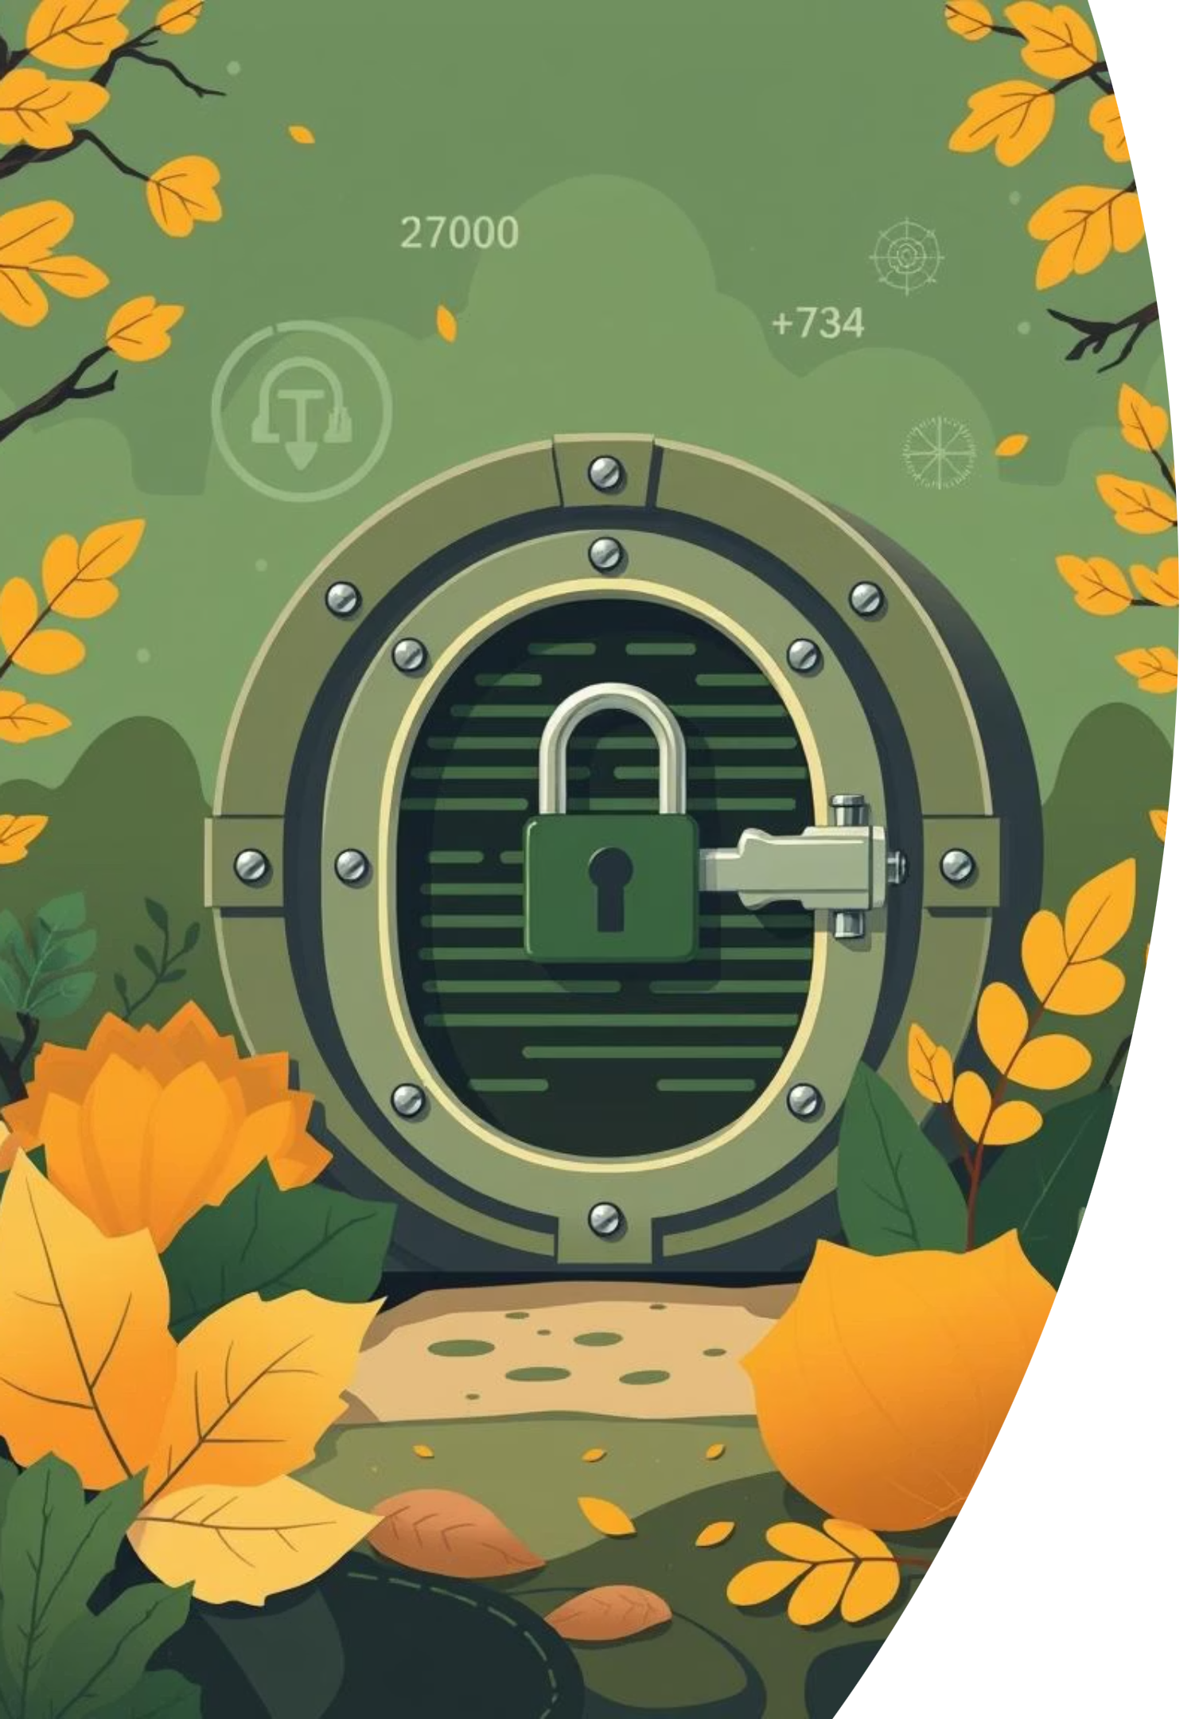
Secure Password Vault
with Multi-Algorithm Lossless Compression and Encryption

Slide 2




Problem Statement
Objective
In the digital age, users manage dozens of accounts, leading to poor password practices. While password managers store credentials securely, they often ignore storage optimization. For large datasets, this results in inefficient storage, backup, and transfer.
Implement multiple lossless compression algorithms (LZMA, DEFLATE, Huffman-only) for password data.
Integrate AES-based Fernet encryption with PBKDF2 key derivation.
Measure and analyze entropy, compression ratio, and processing time.
Provide an interactive dashboard for visualization and analytics.

Slide 3

Abstract
This project builds a secure, compressed password management application using Python and Streamlit. Data is compressed with LZMA, ZLIB, or Huffman before encryption, reducing storage needs and improving efficiency. The system calculates Shannon entropy, compression ratios, and execution time, aligning with ADCT concepts (lossless coding, information theory, entropy analysis, and recent trends). The application also features a password generator and strength checker.
Course Relevance
Maps to Modules 1, 2, 3, 4, and 8 of ADCT — covers lossless compression methods, entropy, Huffman coding, and modern compression trends.

